Slide 1
COM3123 - Lecture 1
Full Stack Web Development

Slide 2
FULL STACK VS MEAN STACK

Slide 3
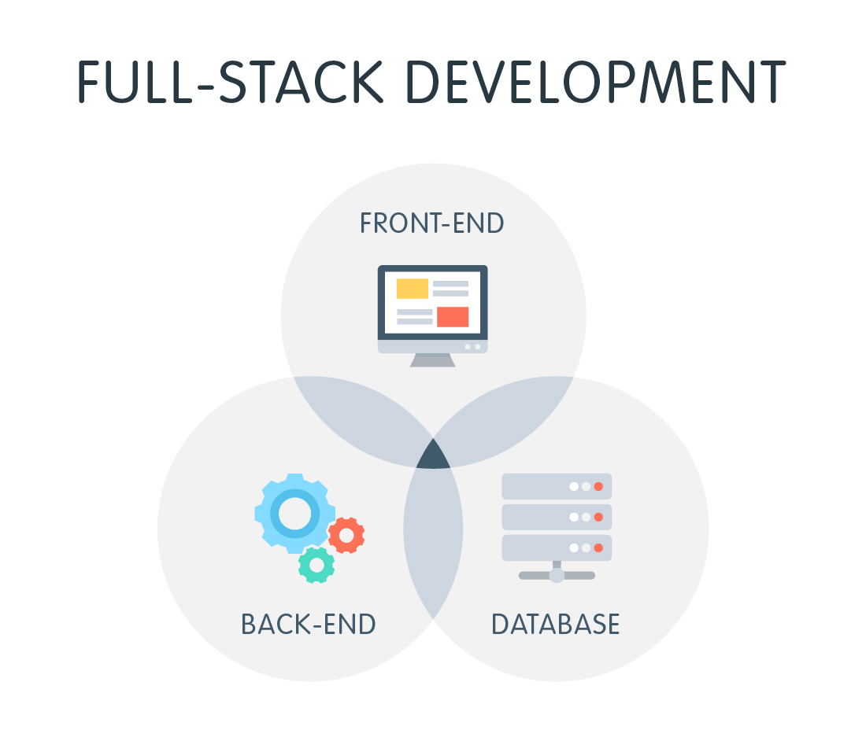

Slide 4


Slide 5
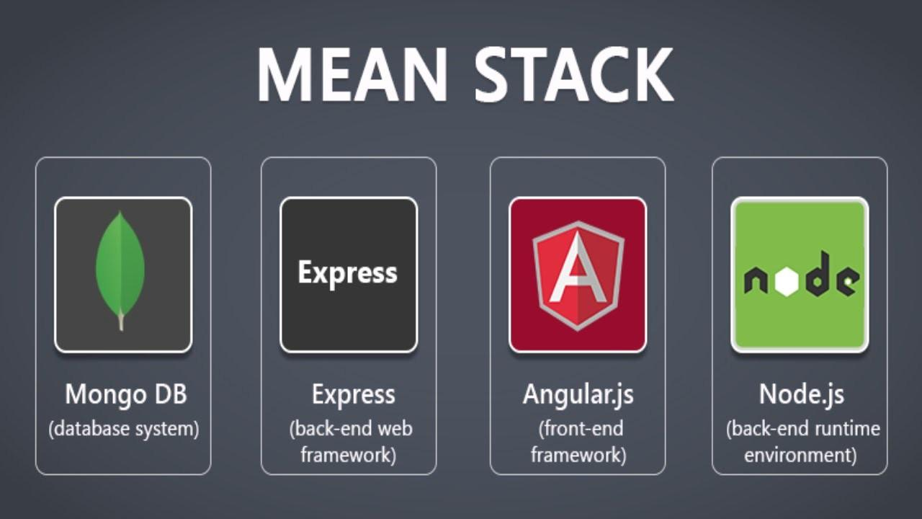

Slide 6
JAVASCRIPT REVIEW

Slide 7
Function Declaration vs Function Expression
A Function Declaration defines a named function variable without requiring variable assignment.
A Function Expression defines a function as a part of a larger expression syntax (typically a variable assignment)
* Function declarations load before any code is executed.
* Function expressions load only when the interpreter reaches that line of code.

Slide 8
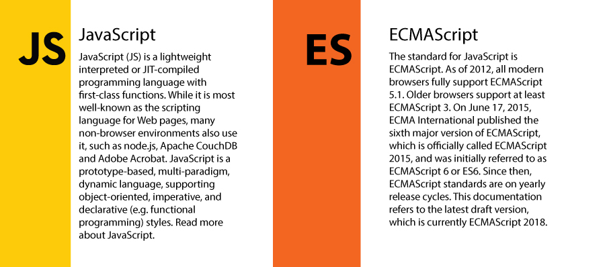

Slide 9
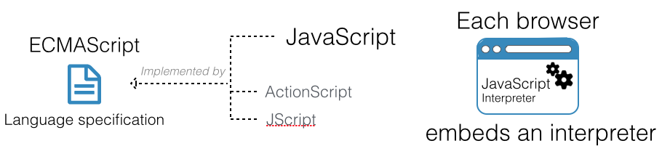
ECMAScript is the standard of Javascript

Slide 10
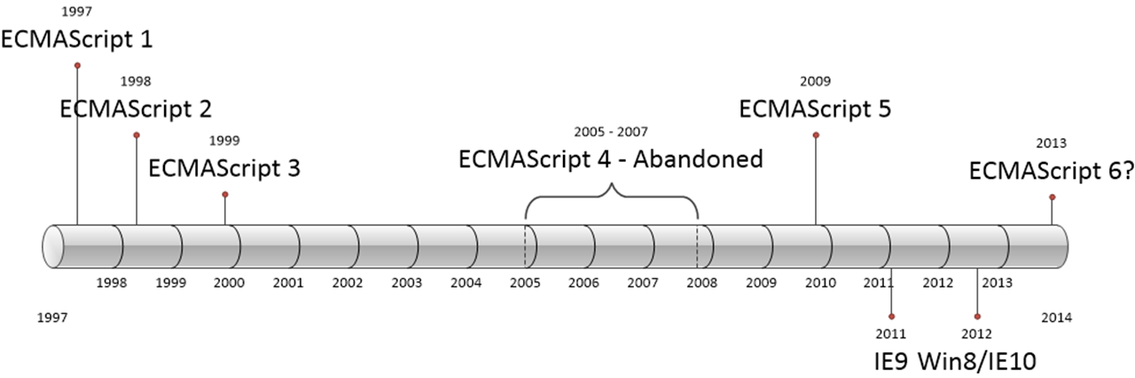
ECMAScript Version History

Slide 11
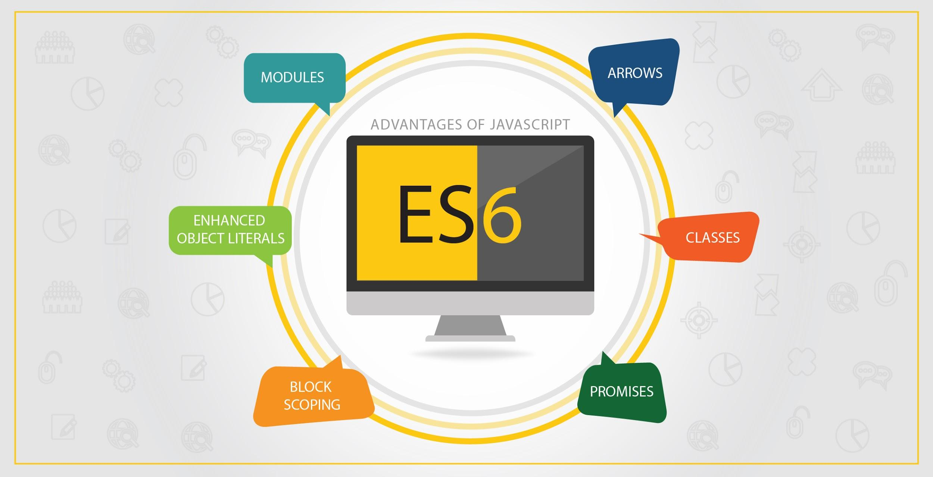

Slide 12
V8: Javascript Engine

Slide 13
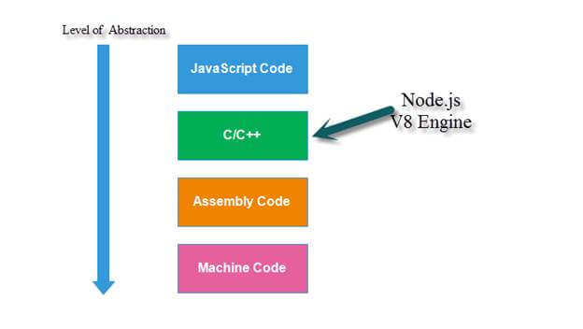
Javascript in Node is converted down to machine code

Slide 14
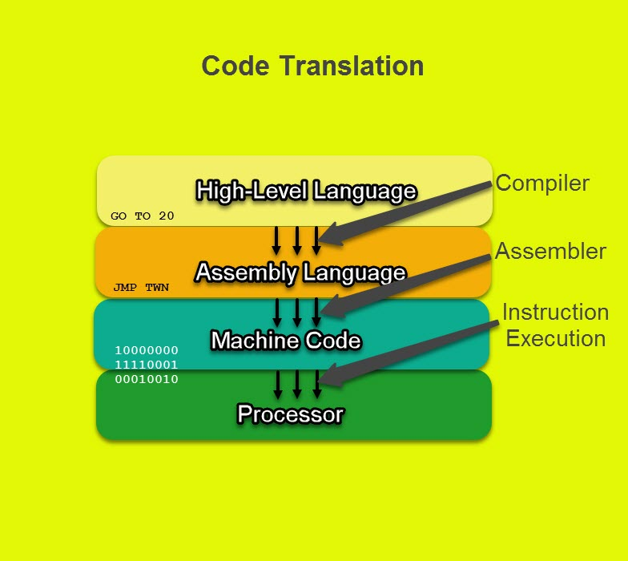
Machine code is instructions that the processor can understand

Slide 15

Chrome V8
V8 is Google’s open source high-performance JavaScript engine, written in C++ and used in Google Chrome, the open source browser from Google, and in Node.js, among others.

Slide 16
THE NODE CORE

Slide 17
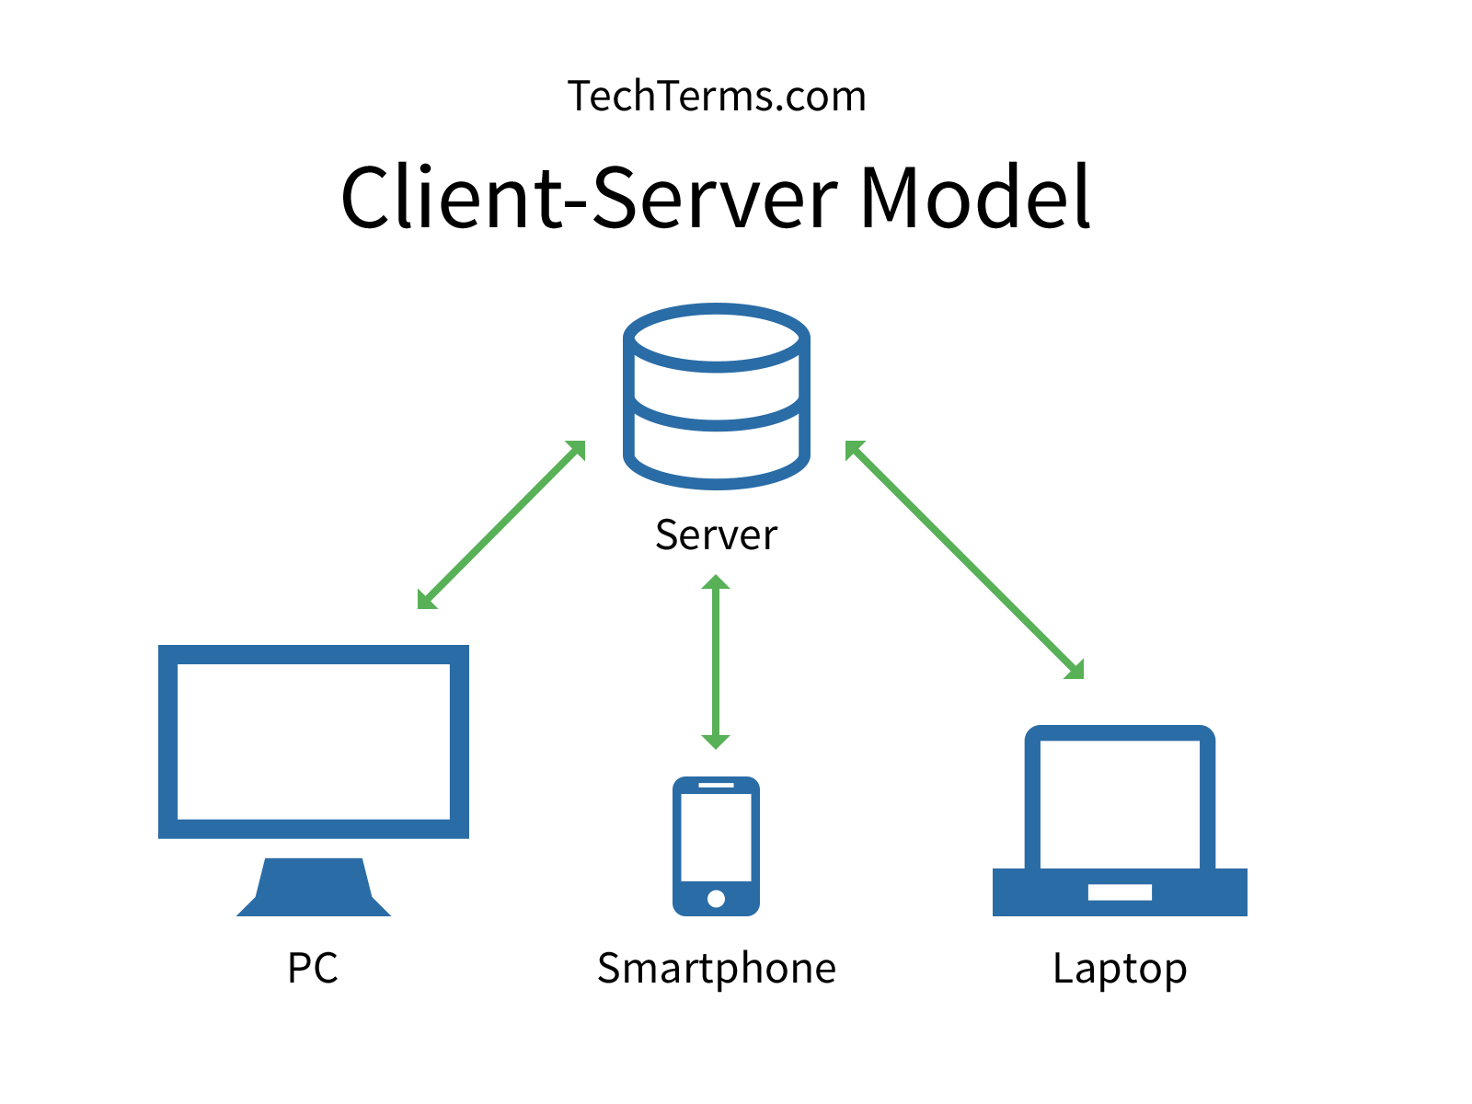

Slide 18
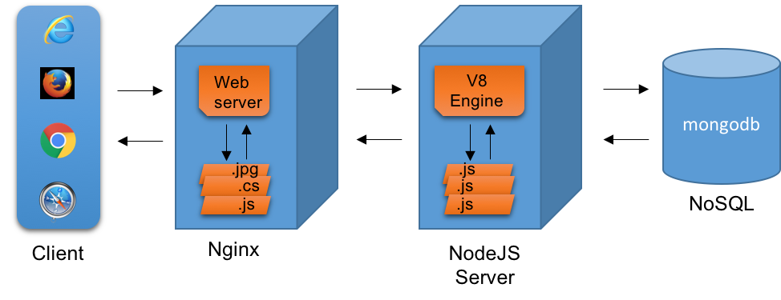

Slide 19
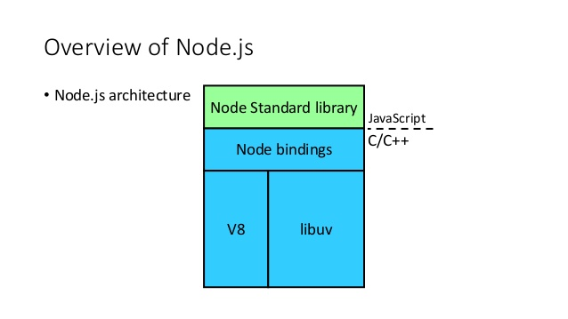

Slide 20
NODE IS WRITTEN IN C++
V8 IS WRITTEN IN C++

Slide 21
What Node needs to be a web server
Needs to organize code into reusable pieces
Needs to deal with files
Needs to deal with databases
Needs to be able to communicate over internet
Needs to be able to accept requests and send responses
Needs to handle tasks that take a long time

